Slide 1
Text and Document Visualization
Prof. Ramesh Ragala
VIT University
Chennai

Slide 2
Text and Document Visualization
Huge resources of information
From libraries
From e-mail archives
Blogs
Wiki
Twitter feeds
Digital library

Slide 3
Text and Document Visualization
The visualizations are task dependent, we can look at what tasks are necessary for dealing with text, documents, or web-based objects.
For text and documents, the most obvious tasks are searching for a word, phrase, or topic.
For partially structured data, we may search for relationships between words, phrases, topics, or documents.
For structured text or document collections, the key task is most often searching for patterns and outliers within the text or documents.

Slide 4
Text and Document Visualization
a collection of documents as a corpus (plural corpora) → deals with objects within corpora. → these objects can be words, sentences, paragraphs, documents, or even collections of documents.
these objects are considered atomic with respect to the task, analysis, and visualization.
Text and documents are often minimally structured and may be rich with attributes and metadata, especially when focused in a specific application domain.
documents have a format and often include metadata about the document
Information retrieval systems are used to query corpora, which requires computing the relevance of a document with respect to a query. → semantic

Slide 5
Text and Document Visualization
compute statistics about documents
the number of words or paragraphs, or the word distribution or frequency, all can be used for author authenticity.
Are there any paragraphs that repeat the same words or sentences?
identify relationships between paragraphs or documents within a corpus.
“What documents relate to the spread of flu?”

Slide 6
Why Visualize Text
Understanding: get the “gist” of a document
Grouping: cluster for overview or classification
Comparison : compare document collections, or inspect evolution of collection over time
Correlation: compare patterns in text to those in other data, e.g., correlate with social network

Slide 7
Text as Data
Documents:
Articles, books and novels, E-mails, web pages, blogs, Tags, comments, Computer programs, logs
Collections of Documents
Messages (e-mail, blogs, tags, comments)
Social networks (personal profiles)
Academic collaborations (publications)

Slide 8
Levels of Text Representation
Lexical level
It is concerned with transforming a string of characters into a sequence of atomic entities, called tokens
Lexical analyzers process the sequence of characters with given set of rules into a new sequence of tokens. → rules → finite state machine defined by Regular expression
Tokens can include characters, character n-grams, words, word stems, lexemes, phrases, or word n-grams, all with associated attributes

Slide 9
Levels of Text Representation
Syntactic level
It deals with identifying and tagging each token’s function.
We assign various tags, such as sentence position or whether a word is a noun, expletive, adjective, dangling modifier, or conjunction.
Tokens can also have attributes such as whether they are singular or plural, or their proximity to other tokens → extracting these annotations is called named entity recognition (NER)

Slide 10
Levels of Text Representation
Semantic level
It encompasses the extraction of meaning and relationships between pieces of knowledge derived from the structures identified in the syntactical level.
The goal of this level is to define an analytic interpretation of the full text within a specific context, or even independent of context

Slide 11
Visualization techniques for text
Word Cloud: word count
It is also known as text clouds or tag clouds, are layouts of raw tokens, colored and sized by their frequency within a single document
Text clouds and their variations, such as a Wordle are examples of visualizations that use only term frequency vectors and some layout algorithm to create the visualization.

Slide 12
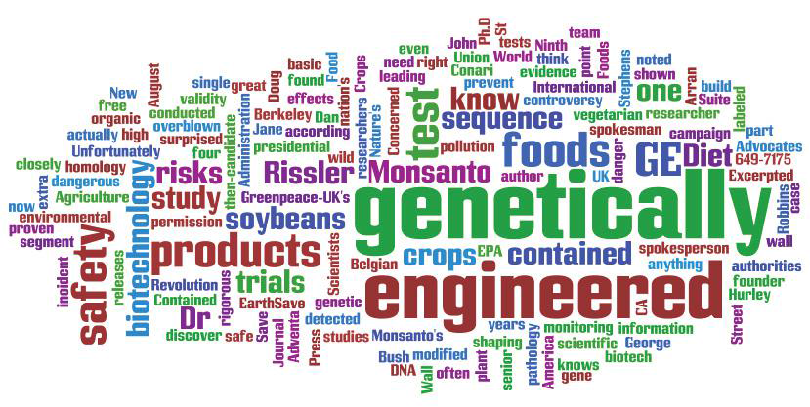
Visualization techniques for text
Word Cloud: word count

Slide 13
Visualization techniques for text
Word Tree: word sequence
The WordTree visualization is a visual representation of both term frequencies, as well as their context.
Size is used to represent the term or phrase frequency.
The root of the tree is a user-specified word or phrase of interest.
The branches represent the various contexts in which the word or phrase is used in the document.

Slide 14
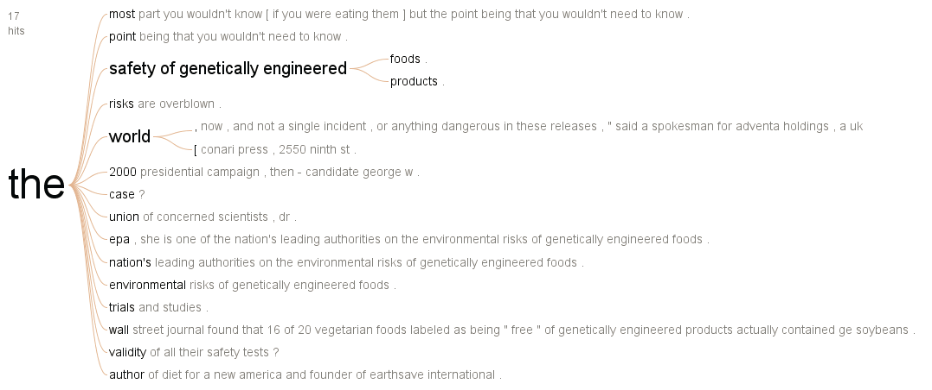
Visualization techniques for text
Word Tree: word sequence

Slide 15
Visualization techniques for text
We can extend the representation of word distribution by displaying connectivity.
There are several ways in which connections can be computed.
TextArc:
It is a visual representation of how terms relate to the lines of text in which they appear.
Every word of the text is drawn in order around an ellipse as small lines with a slight offset at its start
Words with higher frequencies are drawn within the ellipse, pulled by its occurrences on the circle

Slide 16
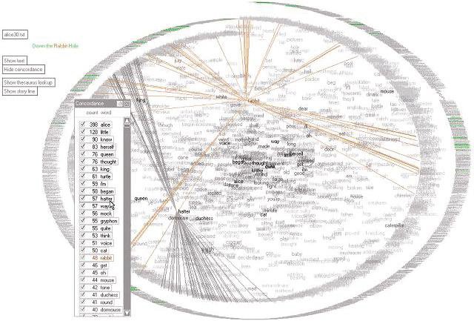
Visualization techniques for text
TextArc:

Slide 17
Visualization techniques for text
Arc Diagrams:
It is focused on displaying repetition in text or any sequence.
Repeated subsequences are identified and connected by semicircular arcs.
The thickness of the arcs represents the length of the subsequence, and the height of the arcs represents the distance between the subsequences.

Slide 18
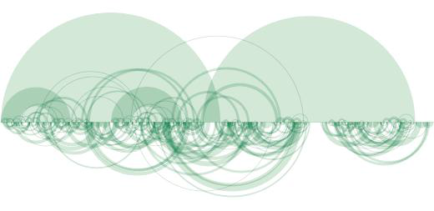
Visualization techniques for text
Arc Diagrams:

Slide 19
Document Collection Visualization
Its goal is to place the similar documents close to each other and dissimilar ones far apart.
This is a min-max problem with complexity O(n²).
The common approaches to
graph spring layouts,
multidimensional scaling
Clustering
self-organizing maps.

Slide 20
Document Collection Visualization
self-organizing maps
It is an unsupervised learning algorithm using a collection of typically 2D nodes, where documents will be located.
Each node has an associated vector of the same dimensionality as the input vectors (the document vectors) used to train the map
We initialize the SOM nodes, typically with random weights.
We choose a random vector from the input vectors and calculate its distance from each node.
We adjusts the weights of the closest nodes (within a particular radius), making each closer to the input vector, with the higher weights corresponding to the closest selected node.
As we iterate through the input vectors, the radius gets smaller.

Slide 21
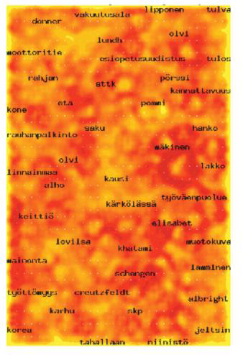
Document Collection Visualization
self-organizing maps

Slide 22
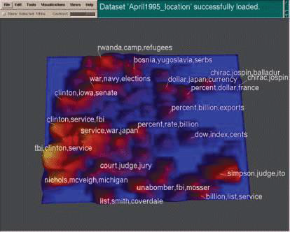
Document Collection Visualization
Themescapes:
Themescapes are summaries of corpora using abstract 3D landscapes in which height and color are used to represent density of similar documents

